Slide 1


The Signal in
the Noise: Why
OpenClaw
Matters Now
Lily Tan
College of Education
Learning Design and Technology
tyaling@purdue.edu

Slide 2
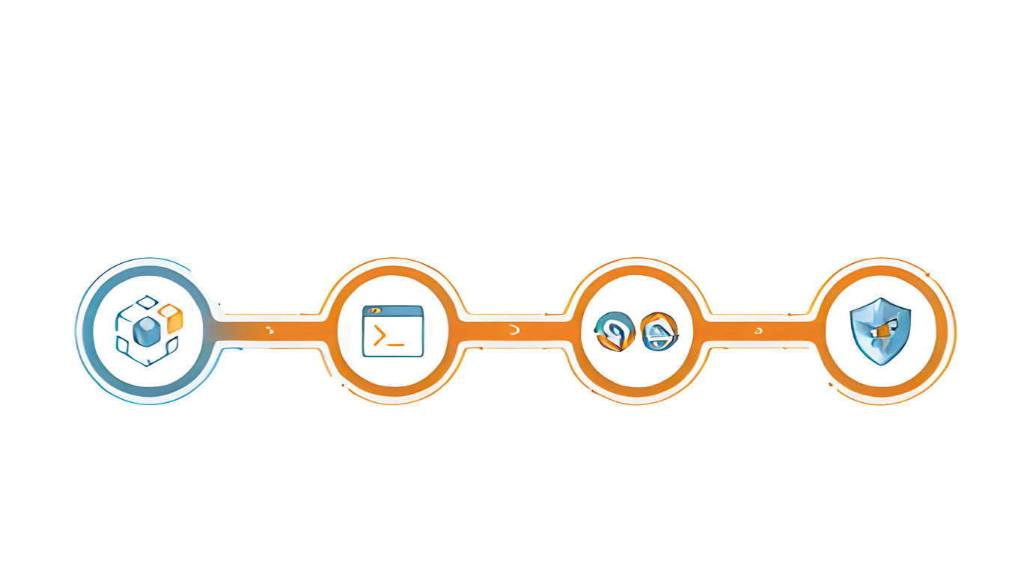

Zero to Agent: The Workshop
We are moving beyond chatting. Build an agent
that remembers your habits, works 24/7, and operates your screen.
SYSTEM. ANALYSIS.v1
> EXEC: SETUP_ENV
PROC: LOOP OPTINIZE
SEC.PROTOCOL: ACTIVE
DATA STREAM
CHEEKPOINT
VERIFY
VERIFY
VERSION 1.0
VERIFY
SYSTER. ANALYSIS.v1
LATENCY: 8.SRS
LATENCY: 6.Ses
LATENCY: 6.Sos
01
02
Deploy
Hello World
Installation
03
Automate
Research & Digest
Workflows
04
Safeguard
Security &
Hallucinations
Deconstruct
Theory &
Architecture
01

Slide 3
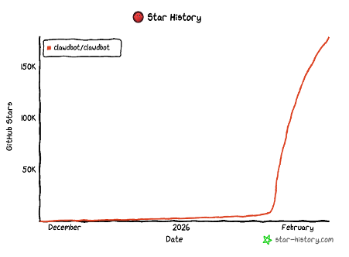
GITHUB STAR HISTORY
https://github.com/star-history/star-history
02

Slide 4
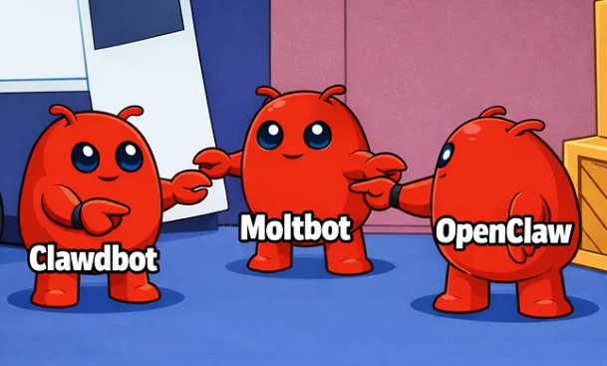
FOUNDER
03

Slide 5
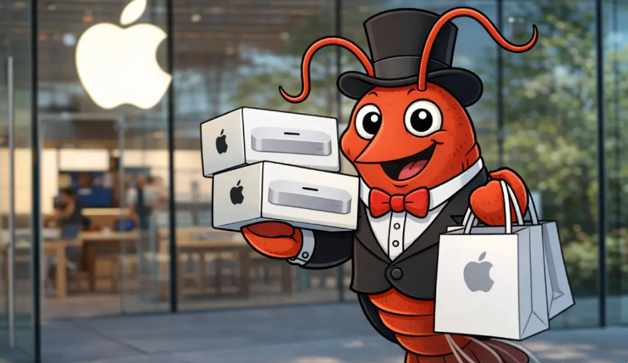
OPENCLAW-FUELED ORDERING FRENZY
04
Notes:
The Mac Mini is a convenient, relatively cheap, low-power box that integrates cleanly with Apple’s ecosystem—especially in regions where iMessage is the default.

Slide 7
BEYOND THE PASSIVE CHATBOT
Standard LLM (e.g., ChatGPT)
OpenClaw Agent
  Passive (Waits for input)
  Amnesic (Session-based memory)
  Active (24/7 Operation)
  Persistent (Memory & Habits)
  Action-Oriented (Screen
& Browser Control)
05
Notes:
1. what llm we have
pro and cons
2. do we need activities
What are newly added features in clawdbot: 1. Memory/preference/habit (if token is needed), so it can remember your routine/smarter 2. Work for 7/24, control and supervise with your phone, take screenshot for you, simple interaction with phone, design a team for you 3. Control with messaging tools, convenience

Slide 8
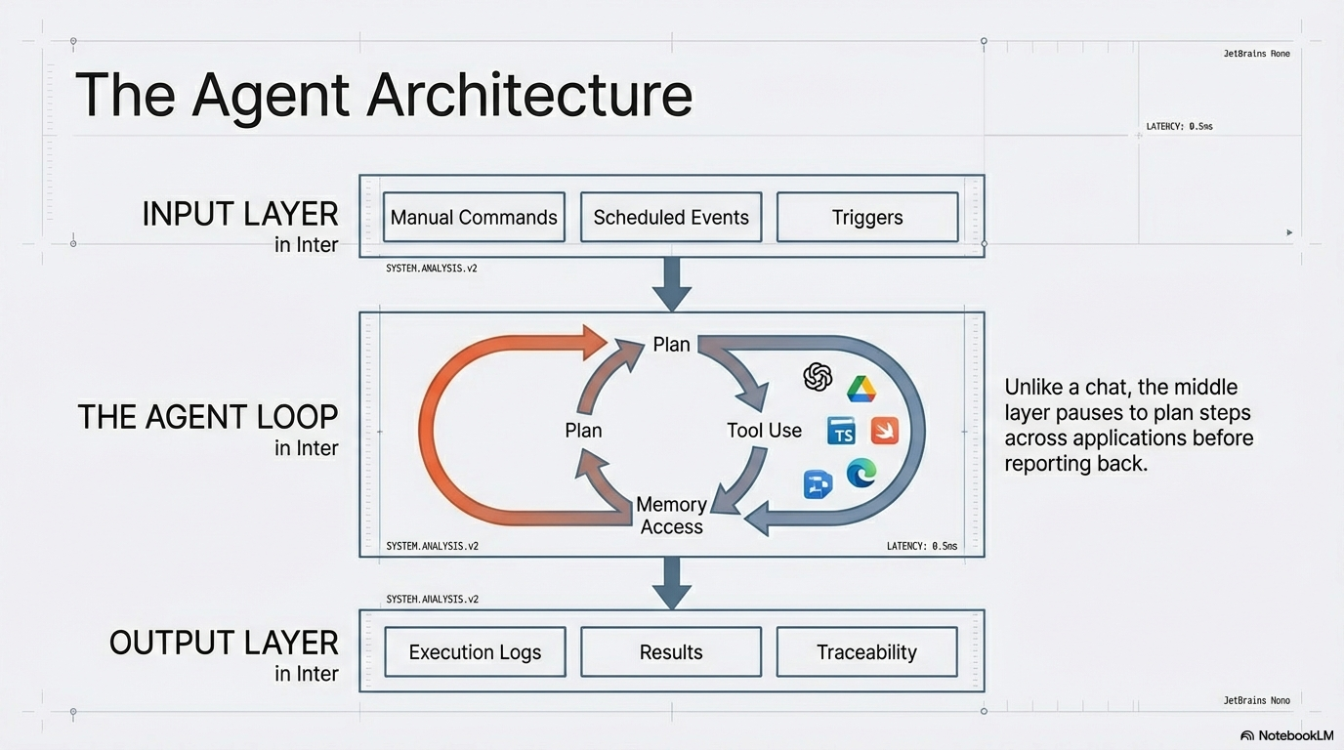
HOW IT WORKS
INPUT LAYER
THE AGENT LOOP
TS
OUTPUT LAYER
06
Notes:
Unlike a chat, the middle
layer pauses to plan steps
across applications before
reporting back.

Slide 9
HOW TO DOWNLOAD
07
Notes:
you might found it's not the prettiest, but it opens up a new world

Slide 10
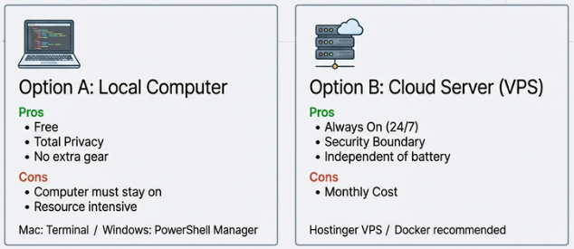
08
Notes:
Run options: 1. Local computer 2. Cloud server/vps (Virtual Private Server) (1. Always on 2. Security 3. No extra gear e.g., histinger VPS, https://www.hostinger.com/vps/docker/openclaw?coupon_cookie=mm-openclaw&utm_medium=influencer&utm_source=aff118104&utm_campaign=557&session=102331e9759bb5119d8e689588d6ce this is not a recommended subscription, optional

Slide 11
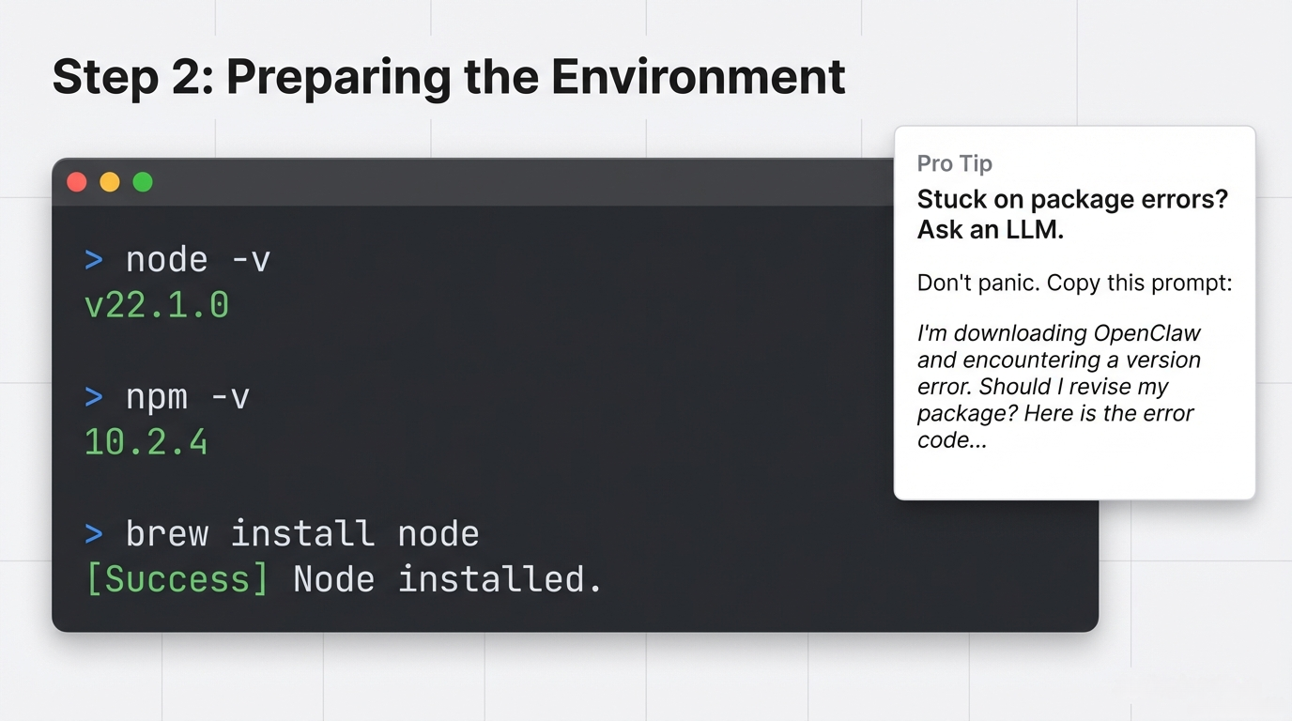
09

Slide 12
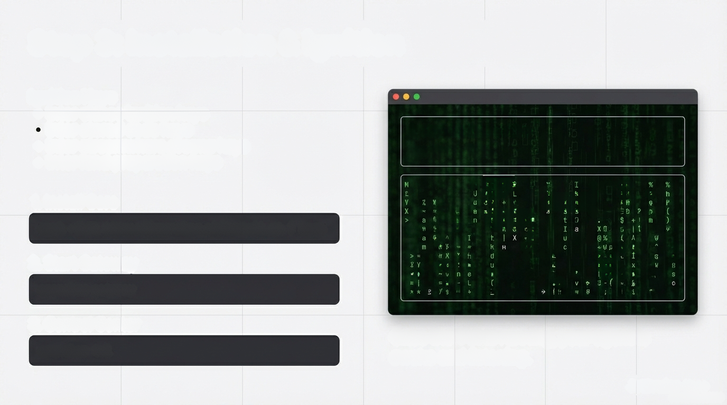
Step 3: Installation & Ignition
Ignition Keys
  Inter chinse Ignition keys
  Inter storad code keys
  Inter streamwhere promp keys
  Inter land preparation keys
System Status: Online
Agents: 1 Idle
9
X-
8
2%
1. Install Core
A 8% 4
D ]
0
83
1
2 R
9
2
2 H
J 2
9
curl -fsSL https://openclaw.ai/install.sh | bash
17
2
a 6
-2
# B
84
k 0
8
b
2. Start Gateway
IN
0-6
g Y
&a
: M
T = -
&H & T
x P
6
openclaw gateway
= 3
- L
.9
7
3. Control Center
Once the TUI is running, your agent is
awake and listening.
openclaw tui
10

Slide 13
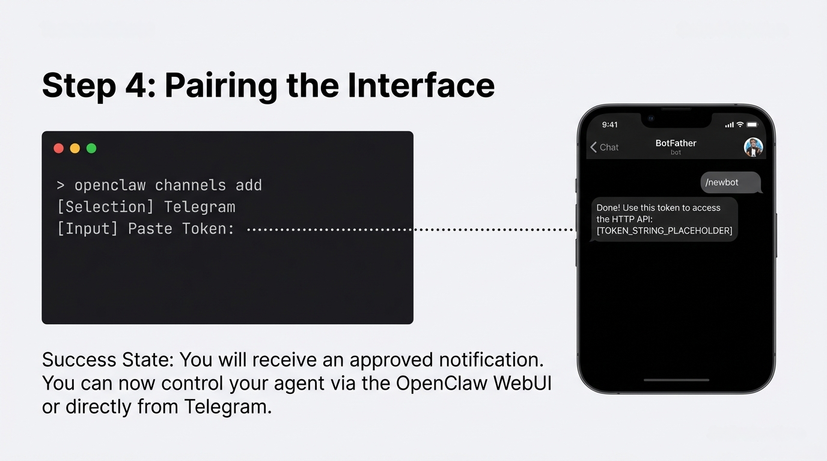
11

Slide 14
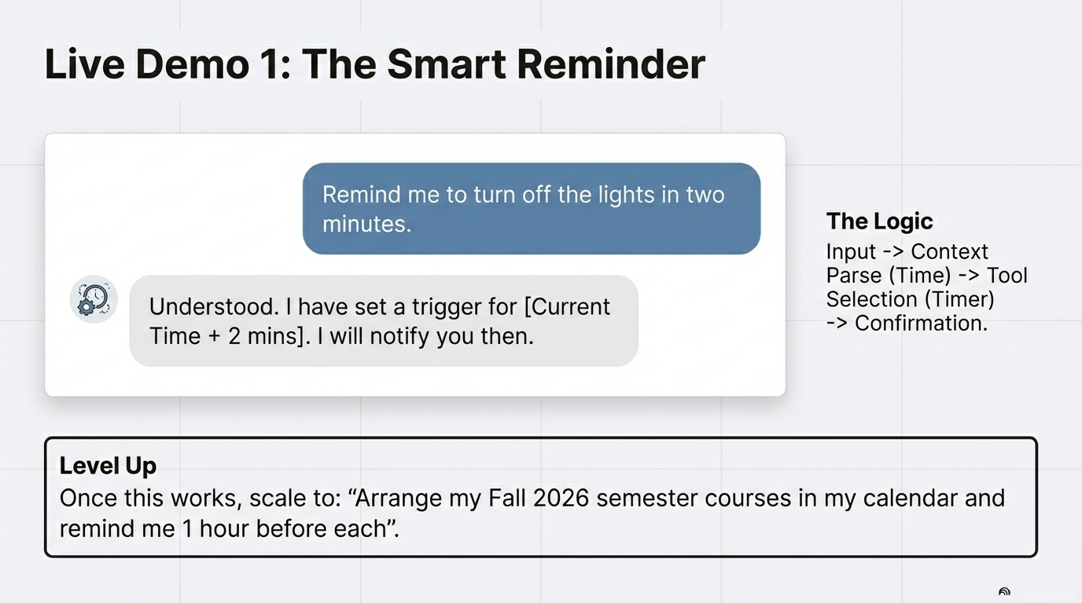
12

Slide 15
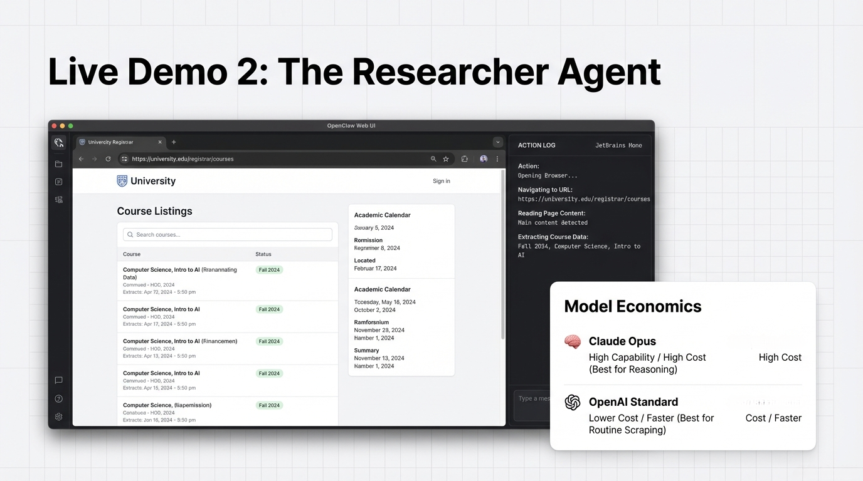
13

Slide 16
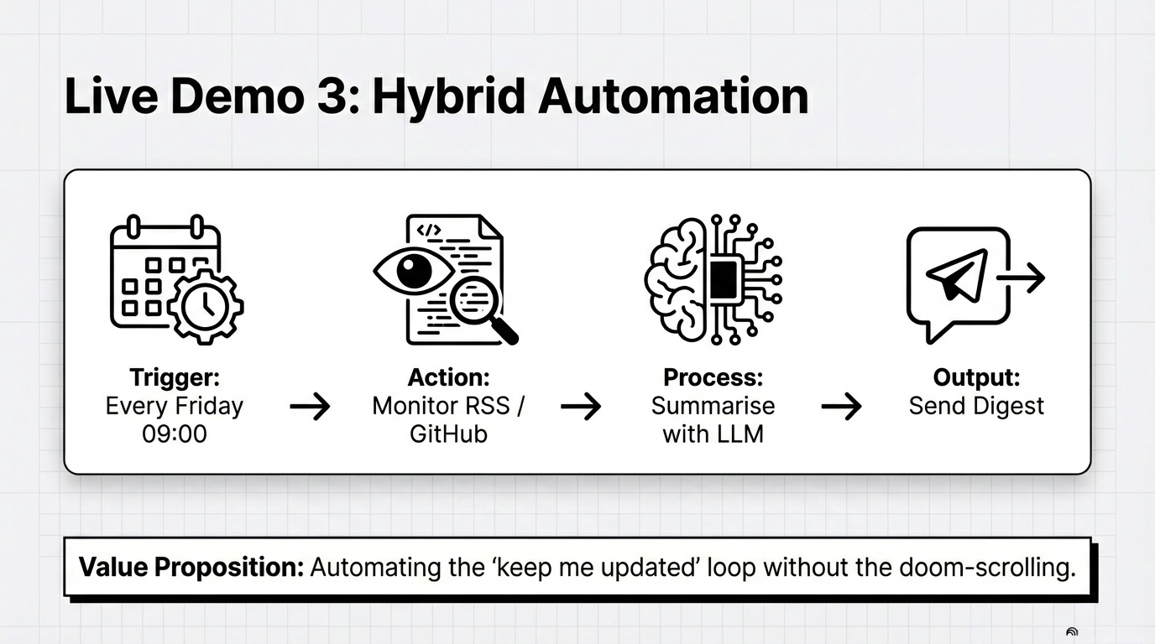
14

Slide 17
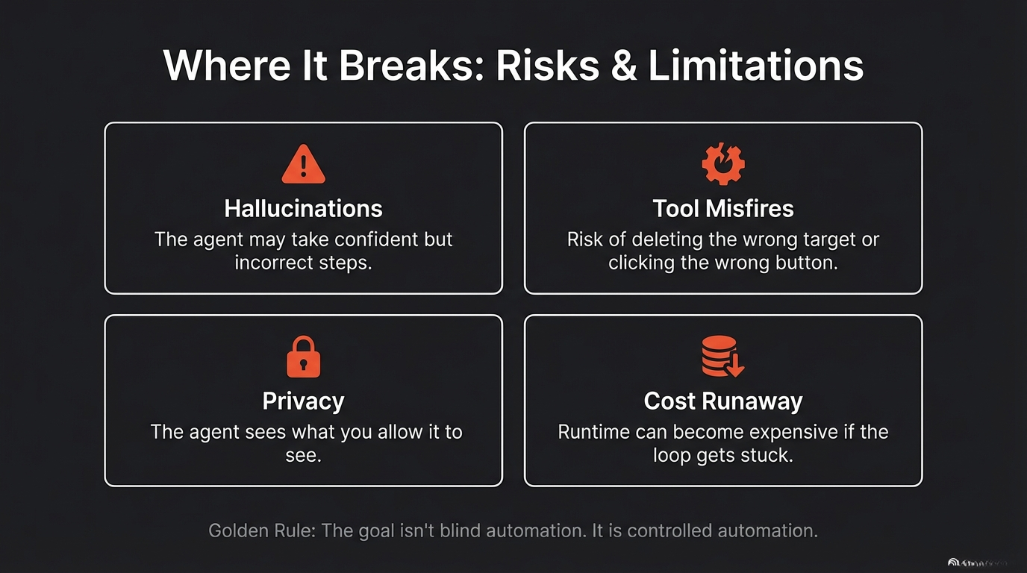
15

Slide 18
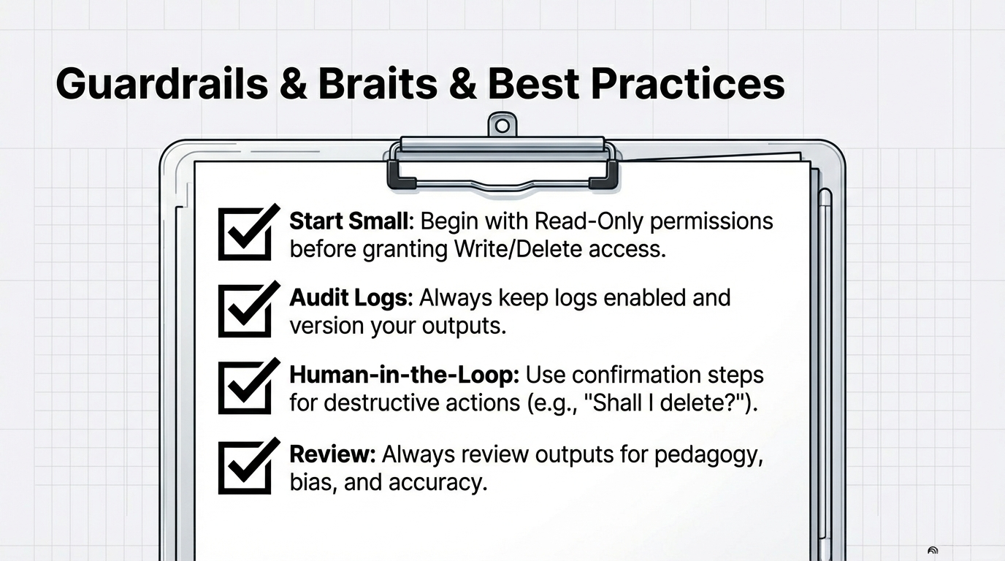
16

Slide 19
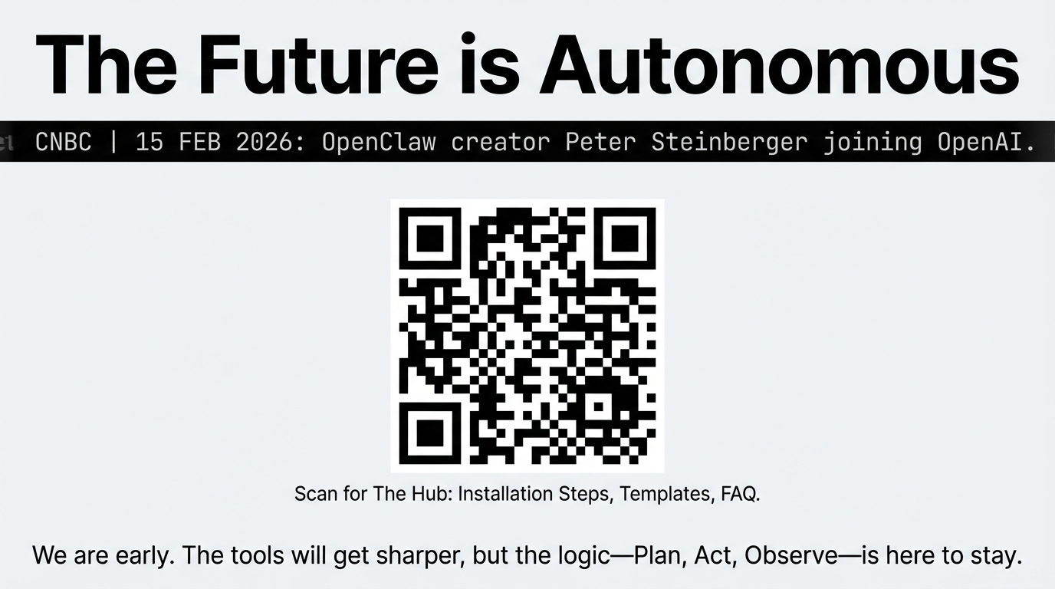
17

Slide 20
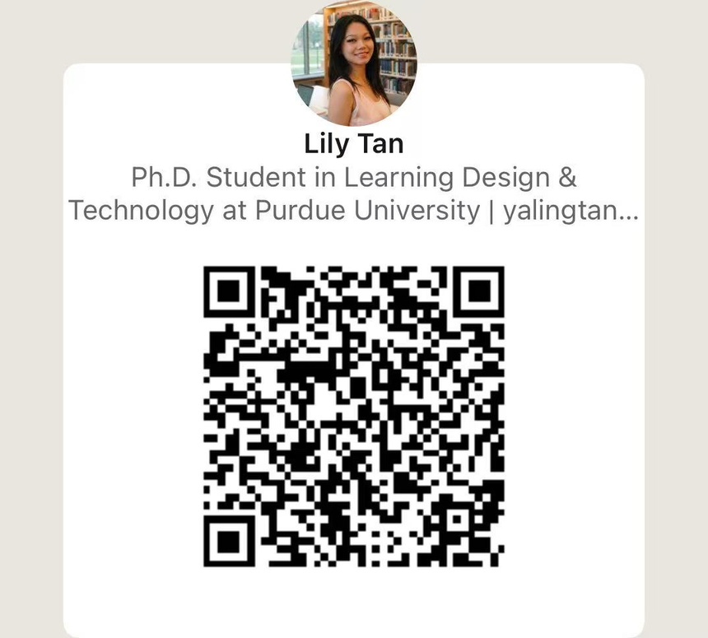
Thank you for your listening!
Scan me for future questions!
Lily Tan
College of Education
Learning Design and Technology
tyaling@purdue.edu

Slide 21
Thank you for your listening!
Scan me for future questions!
Lily Tan
College of Education
Learning Design and Technology
tyaling@purdue.edu

